Slide 1
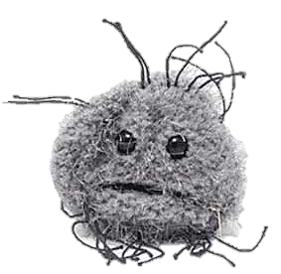
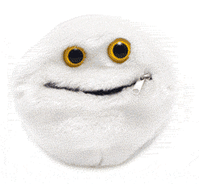
Cancer
Lesson 3.3
How can the immune system cause cancer?

Slide 2
Do now
When do normal cells need to divide?
What stimulates normal cells to divide?
What tells normal cells to stop dividing?

Slide 3
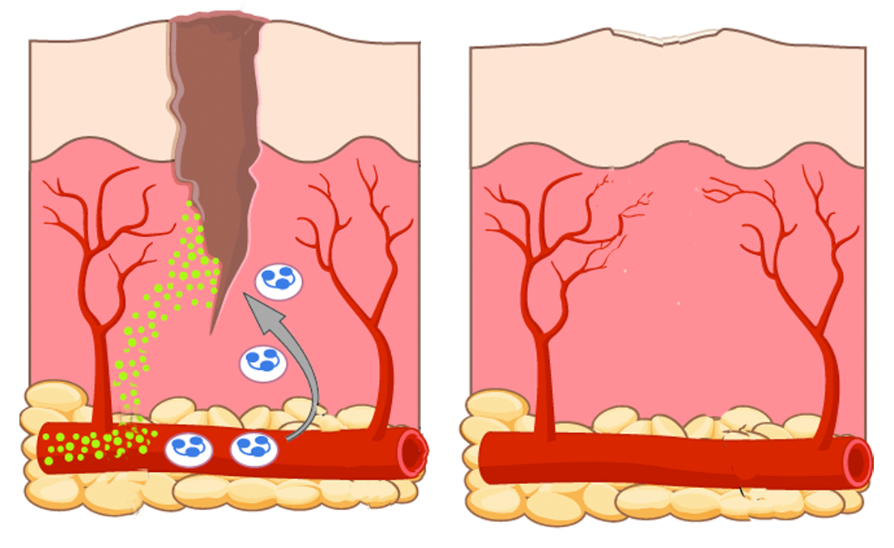
Signals from the wound recruit immune cells
Wound
Inflammatory signals
Scab
Signals from the wound recruit immune cells
Signals from immune cells start inflammation
Notes:
Modified this slide for clarity
Added the word scab, since this is post blood clotting
Also since I couldn’t animate the slide ( it came from the internet), I added the arrow to show the drection of the green signals, and also added in the blue signals to show that they are secreted by the immune cells that are recruited. Also added the legend on the side

Slide 4
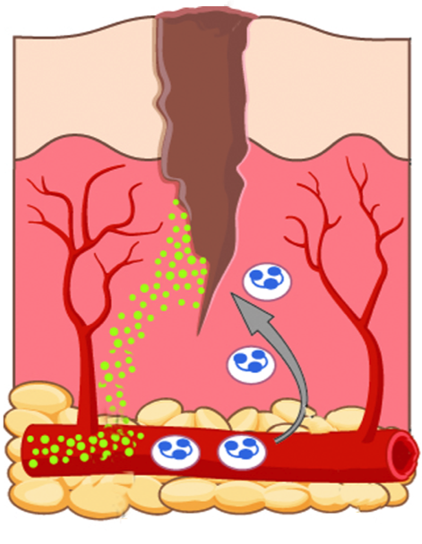
Immune cells secrete growth factors that stimulate proliferation

Slide 5
When tissue is repaired contact signals tell cells to stop proliferating
Cell contact
Wound healed
Proliferation stops

Slide 6
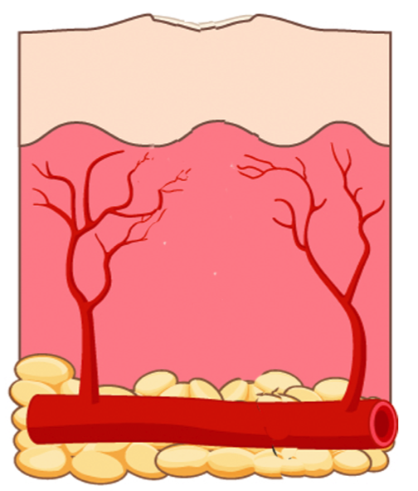
Inflammatory signals also stop when tissue is repaired
Notes:
Added this slide to show that inflammation subsides after repair is done

Slide 7
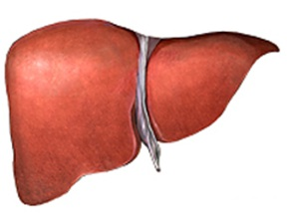
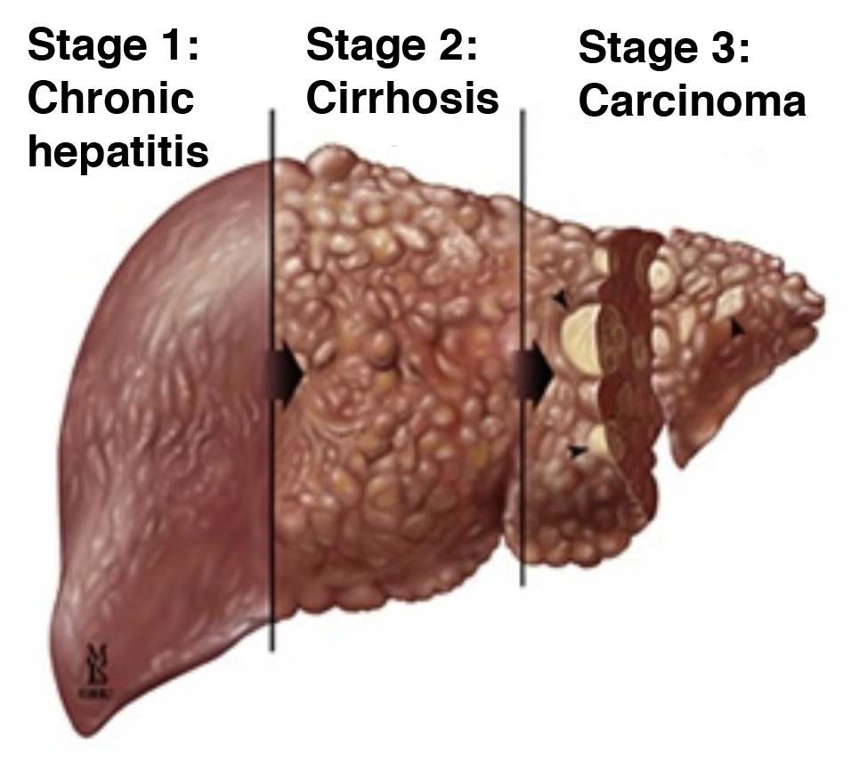
If a wound doesn’t heal, inflammatory signals persist
HBV/HCV infection
Chronic inflammation
Chronic inflammation acts like a carcinogen

Slide 8
Carcinogens cause mutations affecting cell proliferation and death
Tumor suppressor
Normal proto-oncogene
Normal cell
Mutated tumor suppressors
No cell cycle arrest
No cell death
Oncogene
Uncontrolled
proliferation
CANCER!
Notes:
Changed the order of the cars!

Slide 9
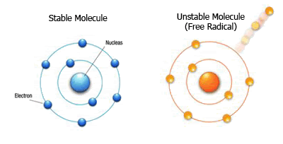
Immune cells produce unstable oxygen (ROS)
Stable Oxygen
Unstable Oxygen
(ROS)
Nucleus
Electron
ROS produced during inflammation kills pathogens!
Notes:
Added this slide because the students were confused by what “oxidative stress meant”- the earlier slide just said the word and said it causes DNA damage

Slide 10
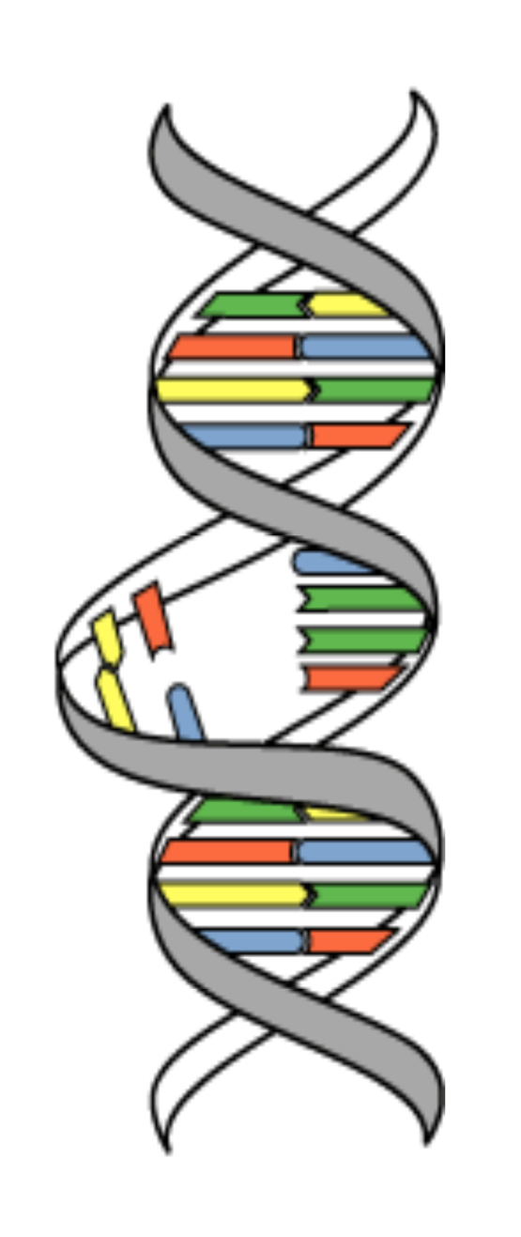
But ROS can also damage DNA!
Chronic inflammation
ROS
DNA mutations
Transformation
Notes:
Modified this slide to include ROS being the damaging agent

Slide 11
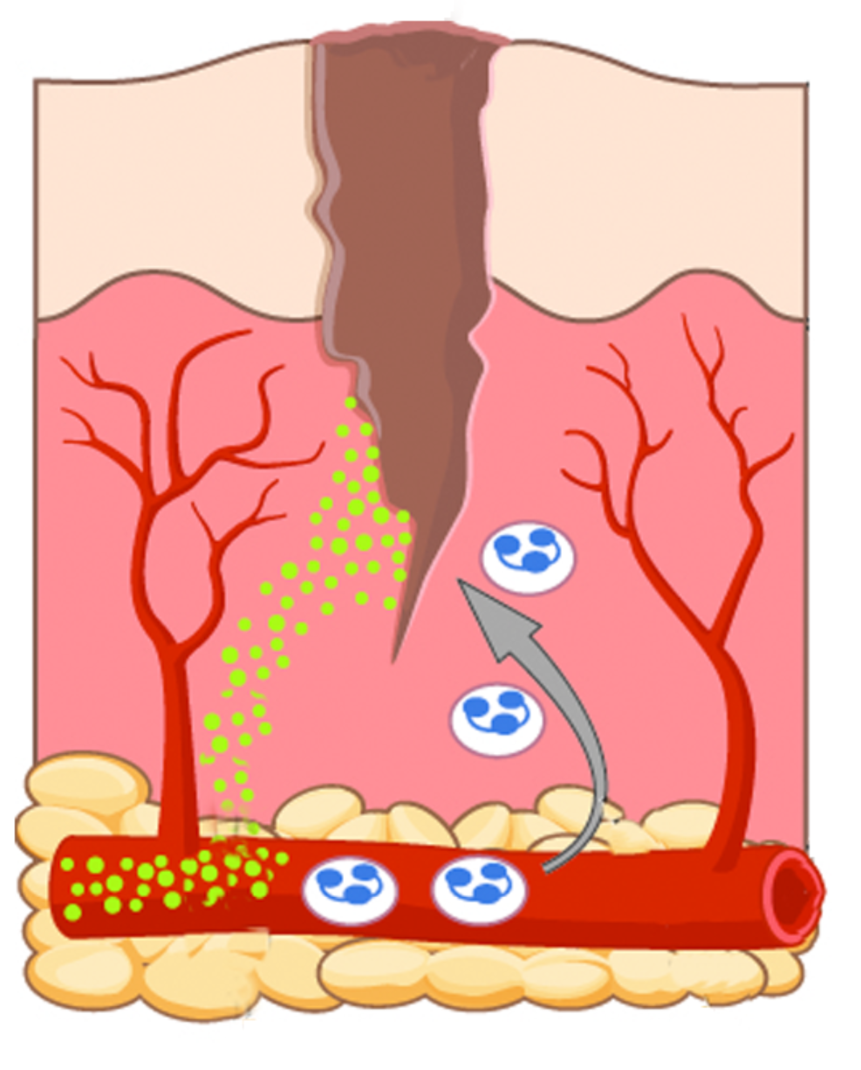
Chronic inflammation leads to proliferation AND mutation
Damaged tissue
Inflammation
ROS
Growth
factors
Rapid proliferation
of mutating cells
Notes:
Added this slide to explain the role of a mutagenic plus pro-growth environment. Had drawn this kind of flow chart to explain the idea to Aimee (because the students were confused, thinking that oxidative stress leads to more proliferation, which is not true)
She then used the same flowchart with them and it helped.

Slide 12
Cytokines in normal inflammation
Damaged tissue
Tumor necrosis factor (TNF)
Inflammation
Healing

Slide 13
Cytokines in chronic inflammation
Damaged tissue
Tumor necrosis factor (TNF)
+
‘Secondary factor’ like infection
Chronic inflammation
Notes:
I think of the Acid reflux as the cause of tissue damage and that leads to continuous production of TNF, chronic inflammation and further damage. So I’m not sure I understand this order. Why are we talking about it as a secondary factor? Why can’t we talk about it as the inducer of chronic damage thus leading to chronic inflammation?
The idea is that the infection is the secondary factor – this is to align it with obesity and alcoholism, it’s the persistent condition that’s inducing the inflammation in the first place

Slide 14
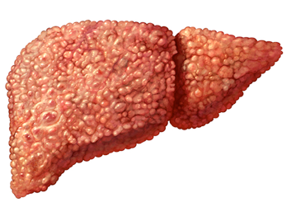
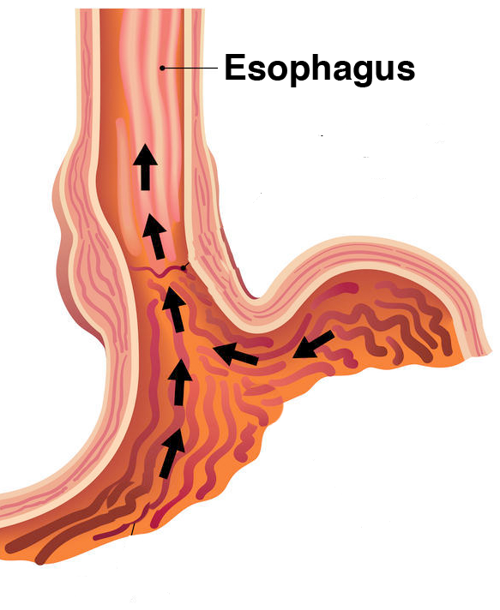
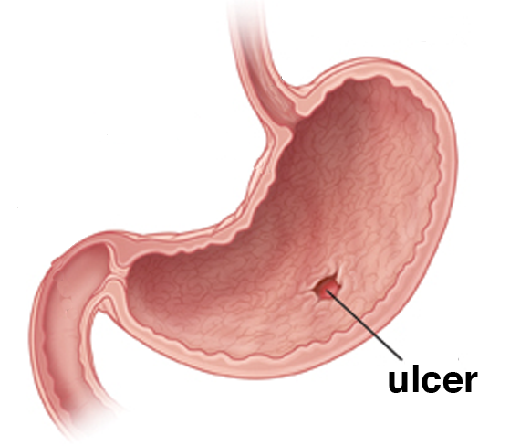
Factors that stimulate chronic inflammation
Fatty liver
Acid reflux
Stomach infection

Slide 15
Activity
Interrupted case study on whether obesity acts as a ‘secondary factor’ with chronic inflammation to promote breast cancer.

Slide 16
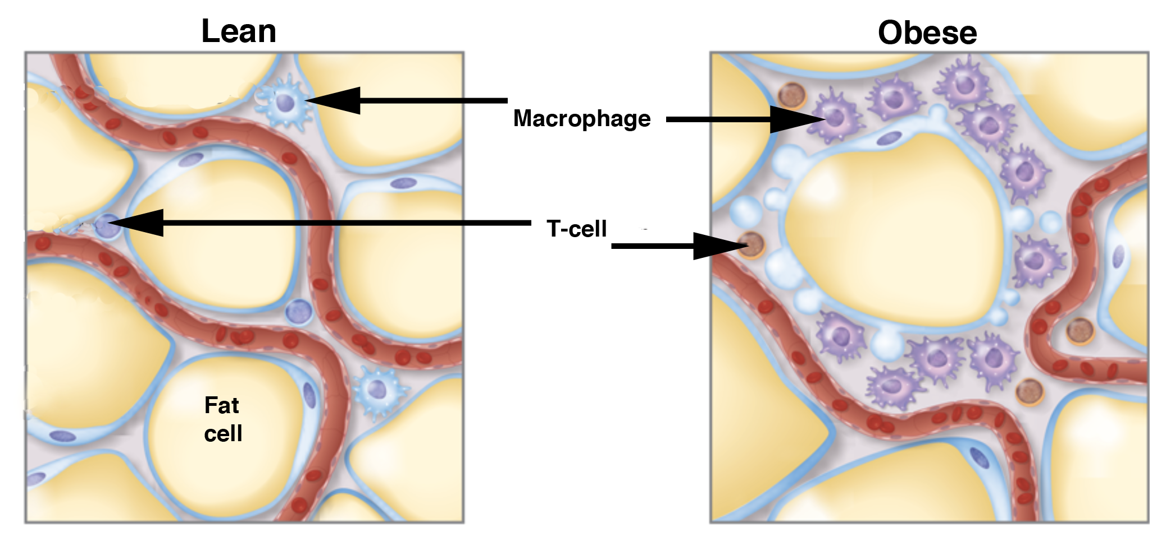
Wrap Up: How could obesity increase cancer risk?
Enlarged fat cells release more TNF
TNF increases cell proliferation and survival – and more TNF.
TNF also leads to inflammation
Inflammation promotes DNA damage and mutations

Slide 17
Wrap Up: Inflammation is involved in 20% of all cancers:
Cancer | Secondary factors
Liver | Viruses (Hepatitis B/C) Liver fluke (parasite) Alcohol
Stomach | H. Pylori infection Alcohol
Pancreas | Mumps virus Alcohol
Cervix | Virus (HPV)

Slide 18
Homework
Read an article about how aspirin may protect against cancer.

